Slide 1
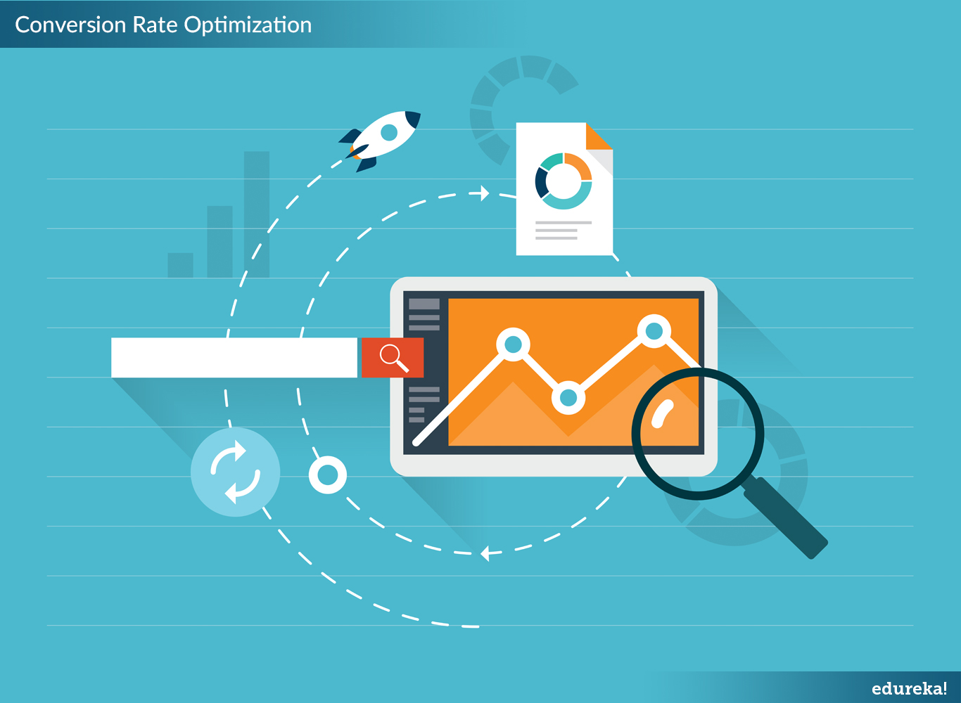
Presenter – Ashish Agrawal

Slide 2

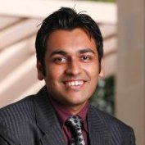
Know your instructor
He has 8 years of experience in the Information Technology and the Digital Marketing Industry. He has worked in companies such as Tata Consultancy Services, Syntel and iQuanti. He is currently working as a Digital Marketing Manager and handling digital campaigns for Fortune 500 companies.
Ashish Agrawal
MBA-IIM, Indore
Digital Marketing Manager, iQuanti, Inc
Course link: www.edureka.co/abc

Slide 3





What will you learn today?
What is CRO?
Benefits of CRO
Why testing is important?
Stages of testing
Types of testing
Hypothesis Development
Motivation
Relevance
Structure
Analysis
Course link: www.edureka.co/abc

Slide 4
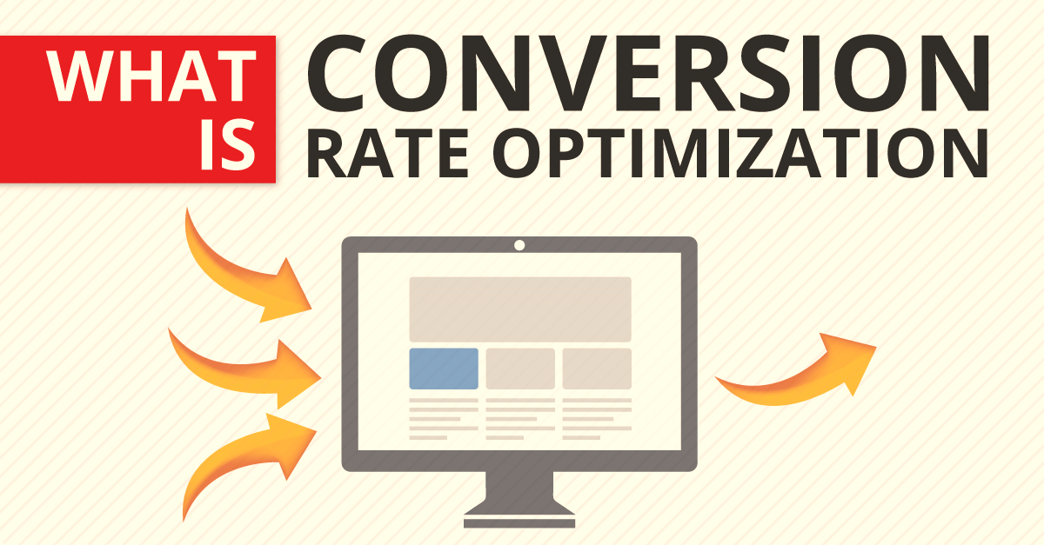
Subject Concepts (Agenda 1)

Slide 5
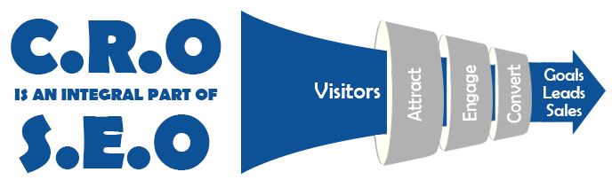
Conversion Rate Optimization
Conversion Rate Optimization is the method of creating an experience for a website or landing page visitors with the goal of increasing the percentage of visitors that convert into customers
Course link: www.edureka.co/abc

Slide 6
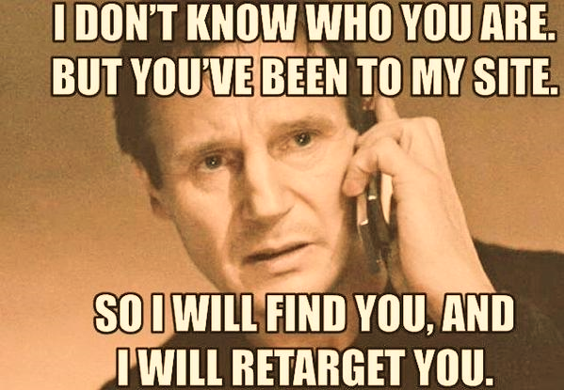
Course link: www.edureka.co/abc

Slide 7
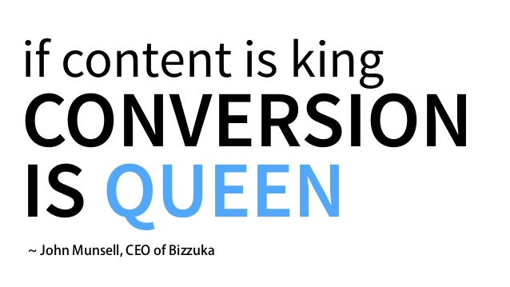
Course link: www.edureka.co/abc

Slide 8
Benefits of Conversion Rate Optimization

Slide 9
Benefits Of CRO
Structured and systematic approach of using analytics and feedback to improve the performance of the website
Performance of the website can be improved by positive movement in Key Performance Indicators (KPIs) on the site
It can be new customer acquisition , newsletter signups, downloads, registrations etc.
CRO takes advantage of the traffic that the site is already receiving and driving them to desirable behaviour
This results in much better return on investment for the traffic that the site is already receiving
This is a much more cost effective process than finding more visitors
Course link: www.edureka.co/abc

Slide 10

Why Test?
History - Direct marketing with an iterative approach
Major shift in marketing enabled by digital – HIPPO vs. customers – vote with clicks
Digital marketers are brought in and, at this point, nearly all big and mid-size organizations are actively doing this
Course link: www.edureka.co/abc

Slide 11
What it takes?
Technology
Find the right tool
Most tools are JS based and are browser-side
People
CRO
Design
Process
Coherent strategy
Clear tactics / plan

Slide 12
Technology | The Optimization Marketplace
Services
professional CRO (conversion rate optimization) expert consulting
Tools
Optimize
Maximizer
Test and target
VWO

Slide 13
Important terms
Term | Meaning
Call to Action (CTA) | The primary button, link or other user interface element that asks the user to take an action that leads to (or towards) a conversion. A “Buy Now” button on Flipkart etc.
Conversion Funnel | The primary pathway (or flow) of the user experience where visitors complete a conversion. On Amazon.com the funnel may be Home page > search results page > product page > checkout.
A/B or Split Testing | The testing of one version of a page or interface element against another version of the same thing. Each element is measured by its effectiveness in comparison to the other. For example, a red button measured in effectiveness to a green button. In A/B testing only one thing is tested at a time.
Multivariate Testing (MVT) | The testing of multiple variations of many different page elements in various combinations to determine the best performing elements and combinations. For example, a multivariate landing test may test many variations of the pictures, copy, and calls to action used on the page in many combinations to find the best performer.

Slide 14
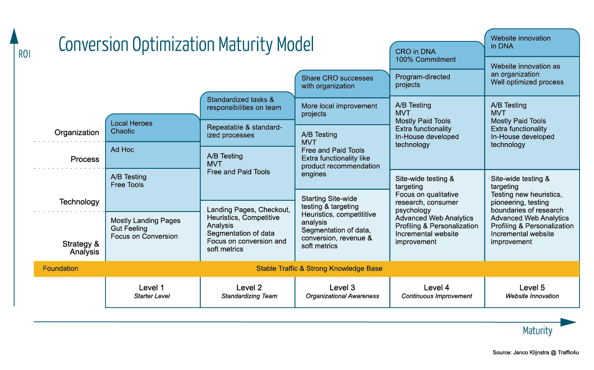
Stages in Testing
Course link: www.edureka.co/abc

Slide 15
Hypothesis Driven Testing
Gather data, onsite and competitor, & sort through the noise
Identify personas, value propositions, key page/s
Establish Macro & Micro KPI’s
Roadmap
Test Plan
Execute - get quick wins & build momentum
Iterate

Slide 16


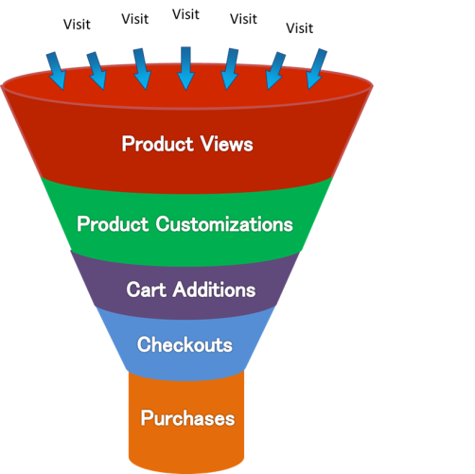
Important terms
E-commerce
Lead Gen
Inquiry
Quality Lead
Win
Course link: www.edureka.co/abc

Slide 17
Role of Landing Page
Campaign 1
Ad Group 1
Ad Copy
Intent
Group 1
LP 1
Campaign 1
Ad Group 2
Ad Copy
Conversion
Funnel 1
…
Intent
Group 2
LP 2
Campaign x
Ad Group 1
Ad Copy
Conversion Funnel 2
…
Intent
Group 3
LP3
Campaign y
Ad Group 1
Ad Copy

Slide 18
Types of Tests
Concept – an experiment testing two or more variations with one component change and is distributed randomly in a live environment
A / B
A / B / n
MVT – an experiment testing multiple component changes at the same time and is distributed randomly in a live environment
Fractional Factorial (Taguchi) – Show a fraction of all possible combinations and draw conclusions
Full Factorial – Show every single combination of page elements. If you have 3 page elements with 3 options each, you would have 27 (3x3x3) combinations. If you had 4 page elements, 2 with 3 options, and 2 with 2 options you would have 36 (3x3x2x2) combinations.
Others (Optimal Design)
Balance – complex doesn’t mean valuable. They are complimentary and can each be used to solve digital business problems

Slide 19



Approach
Before initiating a test program…
Data, data, data
Do not run tests based on your gut. Spend time gathering and sorting through important data.
Numbers don’t paint the whole picture. Gather qualitative data as well
Do a competitor analysis
Plan
Start big or small?
Roadmap in the spirit of continuous testing
Develop clear and simple test plans
Sequentially optimizing the funnel – waterfall
Execute
Fail fast

Slide 20
Job & Career Opportunities

Slide 21
Job & Career Opportunities

Slide 22
What is the topic about?
Pictorial representation
A
B
C
D
Course link: www.edureka.co/abc

Slide 23
What is the topic about?
Pictorial representation
Definition
Course link: www.edureka.co/abc

Slide 24
Case Studies

Slide 25
Career & Certifications

Slide 26

Certifications
How Edureka course will help you scale up your career
Certification Name
Go to www.edureka.co/abc_course
Batch starts from XX October (Weekend/day Batch)
Edureka's XX course:
Introduction of course
How will the course help. What would you gain out of it?
Online Live Courses: xx hours
Assignments: xx hours
Project: xx hours
Lifetime Access + 24 X 7 Support

Slide 27
Thank You
Questions/Queries/Feedback
Recording and presentation will be made available to you within 24 hours

